Slide 1



Neural networks laboratory project
Antonio Trujillo
Alberto Trigueros
Jesús Fuentes
María Peinado
Group C

Slide 2


INDEX
1. Introduction
2. Structure of the application, design choices
3. Experimental results, performance slots, coments

Slide 3

INtroduction
This project is focused on creating a function with the ability of learning. The algorithm should gain knowledge by using several training patterns and a multilayer perceptron neural network. In the following slides, we are going to explain how we got that.

Slide 4
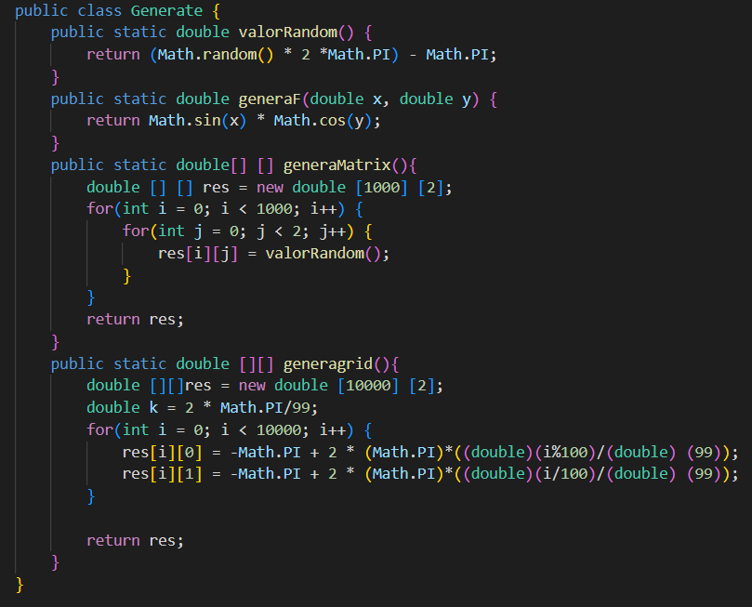


Structure of the application, design choices
We generate random value between -$π$ and $π$
We apply the function given
We create a Matrix to store the random values (to lines for x and y)
We create a Grid were the first column is for values x, the second one is for y.

Slide 5
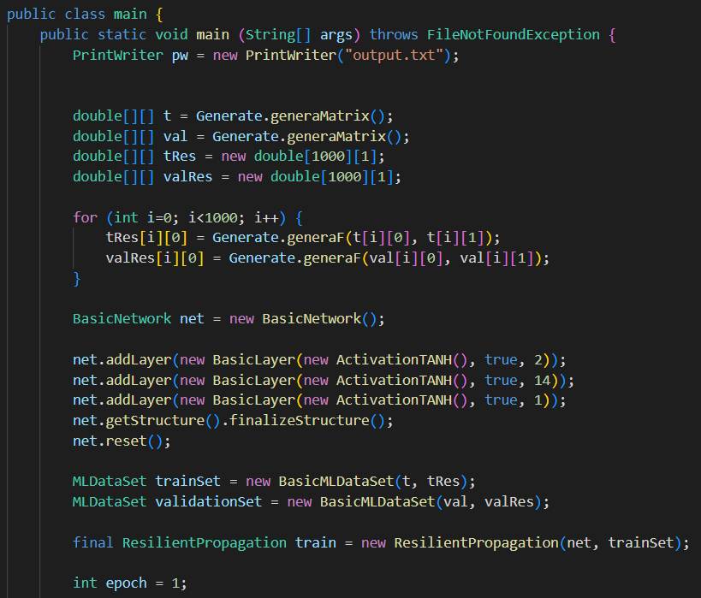
Structure of the application, design choices
We generate the training and the validation matrix using the class Generate we have just created.
And also the matrix for the results for each of them
Applying F (generaF) we obtain the values of the results for the training and the validation Matrix
We create the network
For the first layer we have un neuron for each input.
After trying diferents values we choose 14 neurons for the second layer
Finally, the last layer for the output
We start with the training and the validation
We have choosen activationTANH because it was the one which best fitted with our algorithm

Slide 6
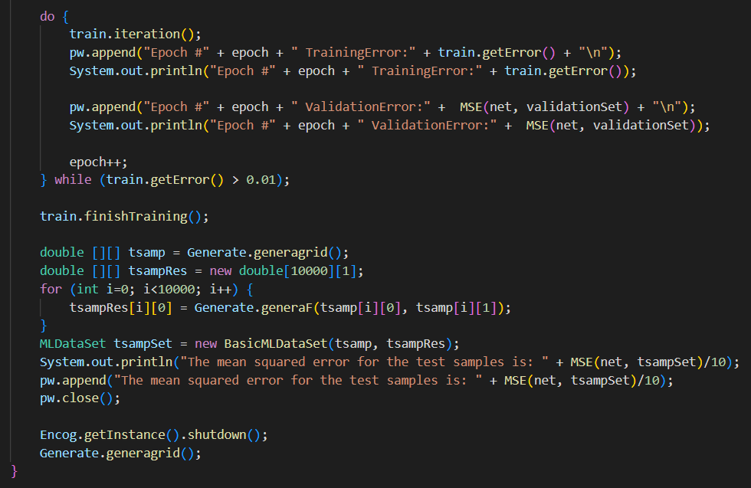

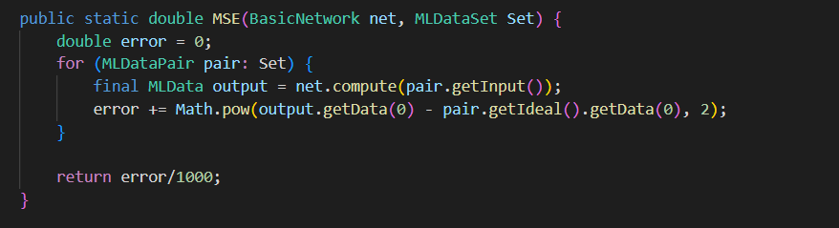
Structure of the application, design choices
We set up the error in 0,01 for obtaining a better results, so it started training until it get an error lower than the established.
Now we are using the grid. tsamp contain the coordinates, whereas the tsampRes contain the F result.
Finally, we compute the mean cuadratic error of the test simples with the same algorithm used before but now dividing the result by 10 because we have 10000 simples now.
For calcuting the validation error = MCE, we have added consecutively the square of the difference between the ideal result and the obtained for all values gotten.

Slide 7
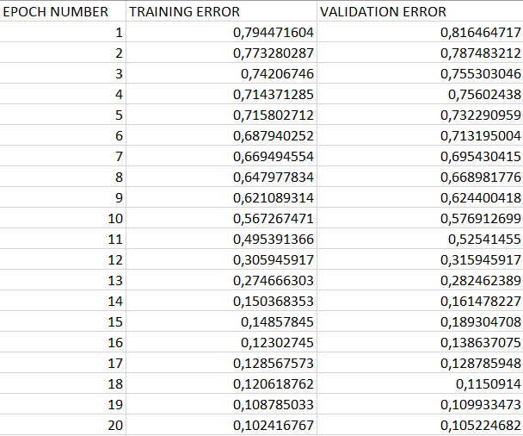
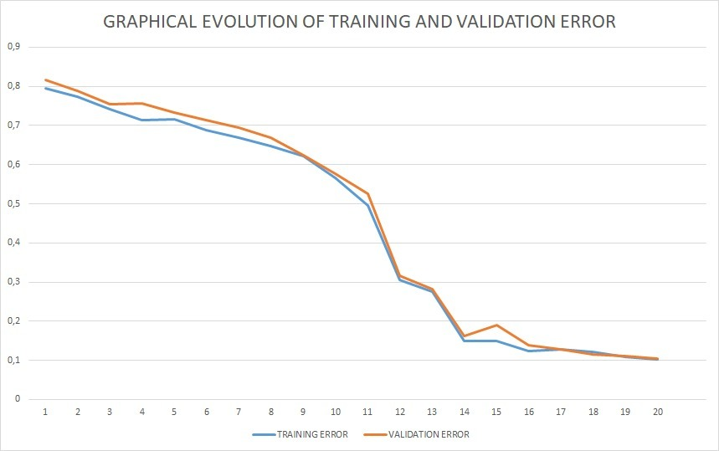
Experimental results, performance slots, coments
As we can see, while the epoch number increases, the error decreases, in training as in validation, which means that the network is training successfully.
This is before reaching a threshold established, that is when we consider that it is enough trained (demostrated by calculating the MCE).
The training error y lower than the validation one, and they are finally getting clores

